Slide 1
Questions/Comments
What should I add?
How can I make my presentation look nicer?
How can I be more clear
I would add some slides that explain how you changed the original picture to achieve your goal (which was not really stated). Draw comparison to the original (did you even show the original at some point?)

Slide 2
Modeling Image Effects using MATLAB
By Andrew Katz
Instructor: Nicholas Dwork
Stanford Pre-Collegiate Summer Institutes 2015

Slide 3
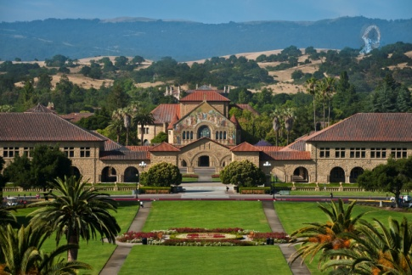
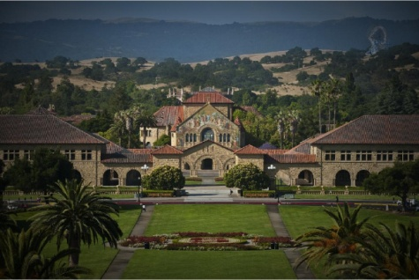
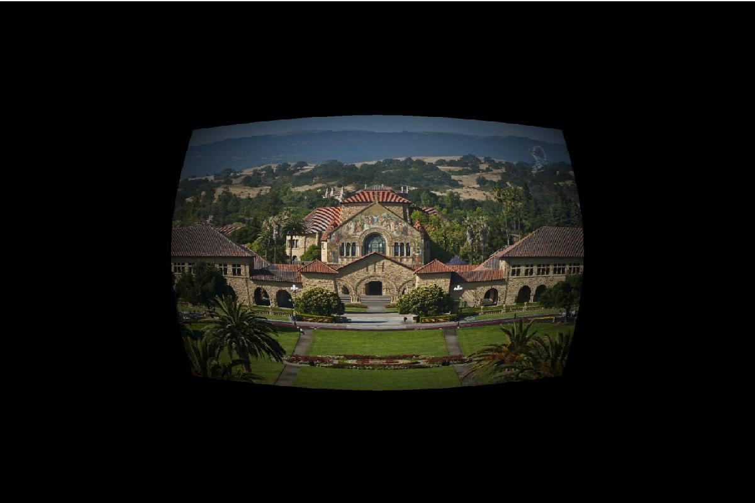
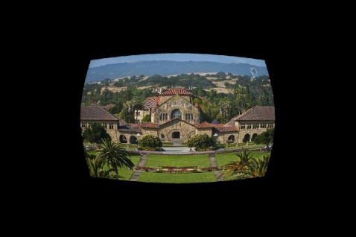
Applying Image Effects
Image effects can be applied as a function of pixel location to an image as a matrix.
These effects only apply to a single color, so an effect must be applied three times, for full color.
Clockwise from the top left: Original, vignette, radial distortion, vignette and radial distortion.

Slide 4
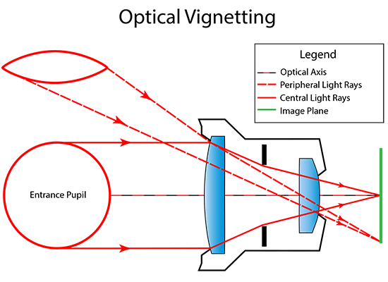
Vignettes
A vignette occurs because imperfect lenses refract differently towards the edge, and less light reaches a pixel in the center.^{[1]}
A vignette can be modeled by cos⁴(θ)
A vignette may be simulated in computer graphics for animation, etc…
https://cdn.photographylife.com/wp-content/uploads/2013/10/Optical-Vignetting.png

Slide 5
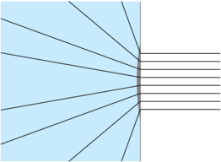
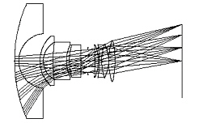
Radial Distortion
Radial Distortion occurs as a lens artifact, often with long range zoom lenses^{[2]}
Radial Distortion can be modeled with a Taylor Series, a polynomial which as the degree increases, the function more closely matches the true, infinite series it models.^{[2],[3]}
http://i.stack.imgur.com/Y4cJx.png
http://www.bobatkins.com/photography/technical/fov/raytrace.jpg

Slide 6
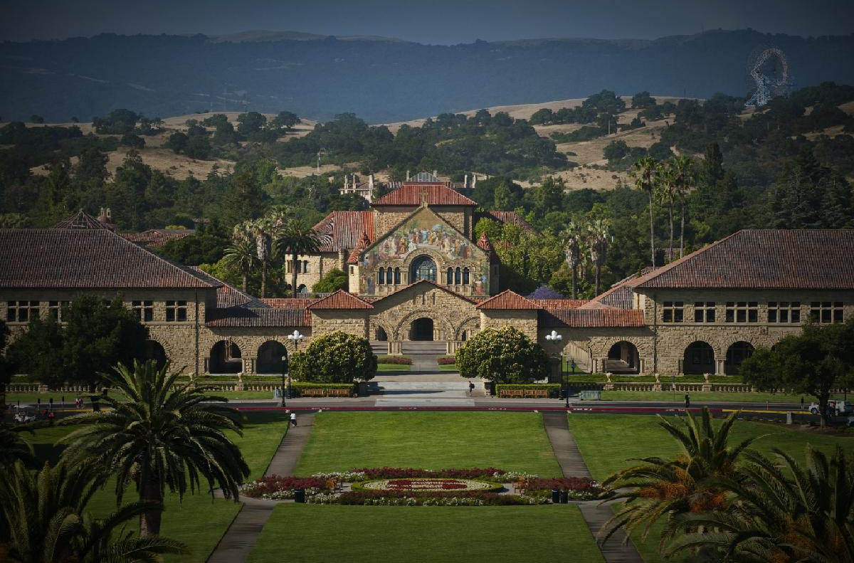
Vignetting

Slide 7
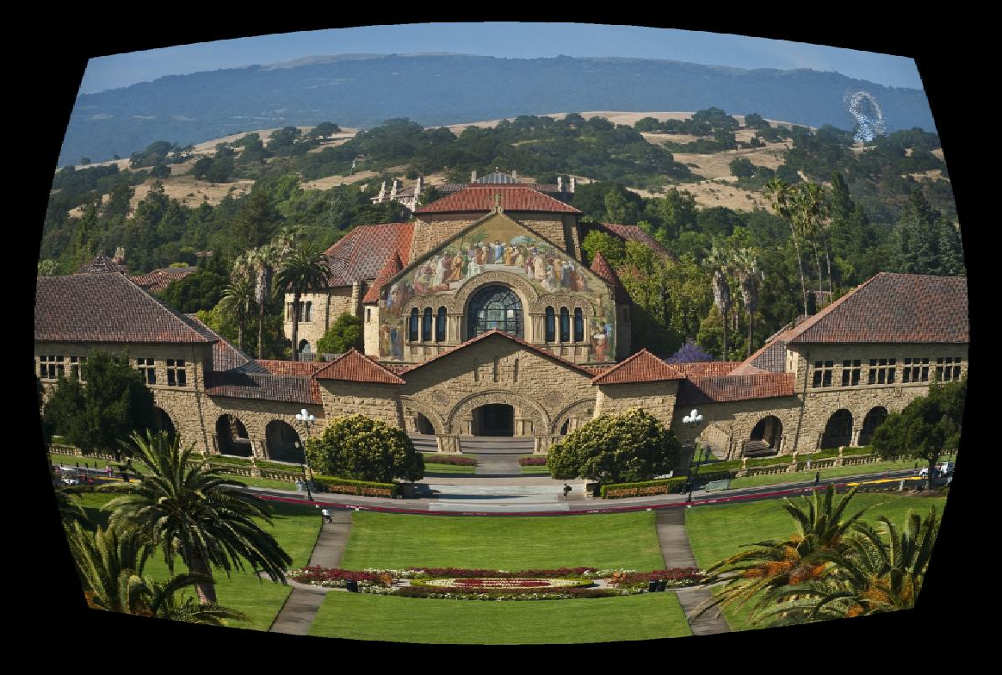
Radial Distortion (Fisheye)

Slide 8
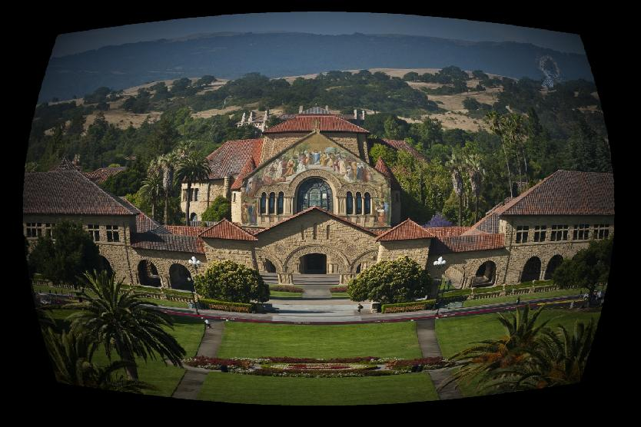
Radial Distortion and Vignetting

Slide 9
References
https://en.wikipedia.org/wiki/Vignetting
https://en.wikipedia.org/wiki/Distortion_(optics)
https://en.wikipedia.org/wiki/Taylor_series
Code for this project is available at: https://github.com/aakatz3/SPCS2015FinalProject/

